Slide 1
Computer Organization
Dr.Parkavi.A, Associate Professor
Dept of CSE,Ramaiah Institute of Technology
Bangalore

Slide 2
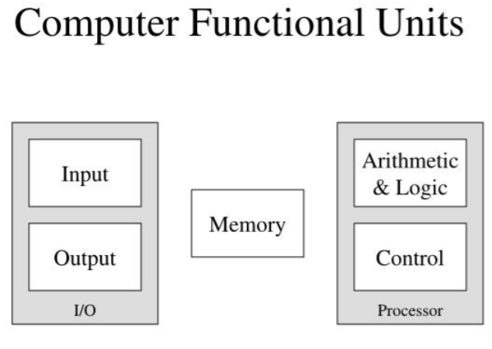
Functional Units

Slide 3
Functional Units
Instructions or machine instructions
Information transfer
Operations
Program
Compilation
ASCII
Input
Key press

Slide 4
Memory unit
2 types
Primary
RAM
Cache
Secondary
Memory cells
Bits
Words
Address or locations
Word length
Memory access time

Slide 5
Functional units
ALU
Add 2 numbers
Registers
Output unit
Eg. Printer
Control unit
I/O programs
Timing signals
Control lines
Operations of computer
I/P, Memory, CPU, CU, O/P

Slide 6
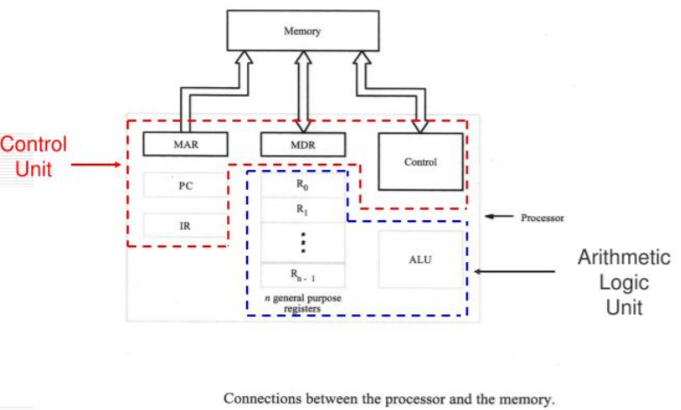

Slide 7
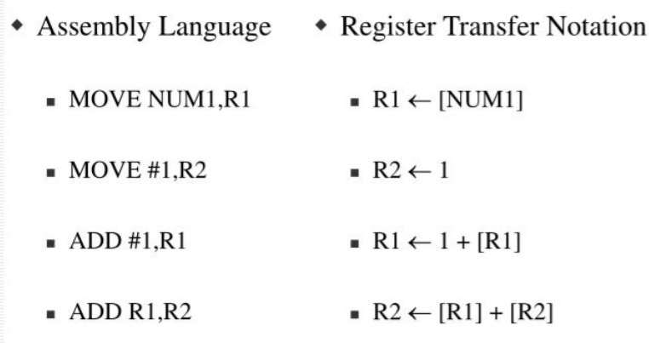
Operations
Eg:
Add LOCA,R0
Load LOCA,R1
ADD R1,R0
ISR→
Interrupt service routine

Slide 8
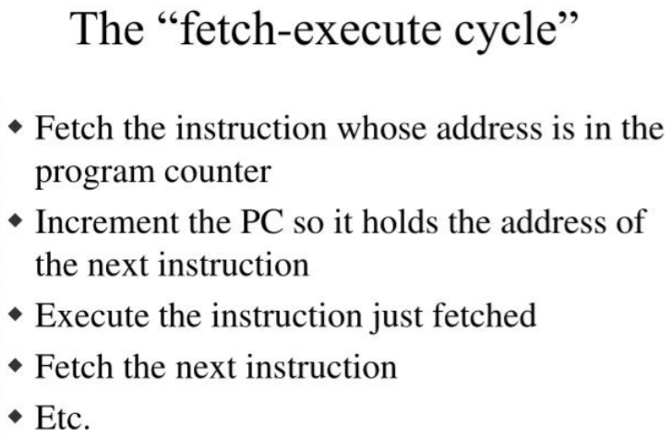

Slide 9
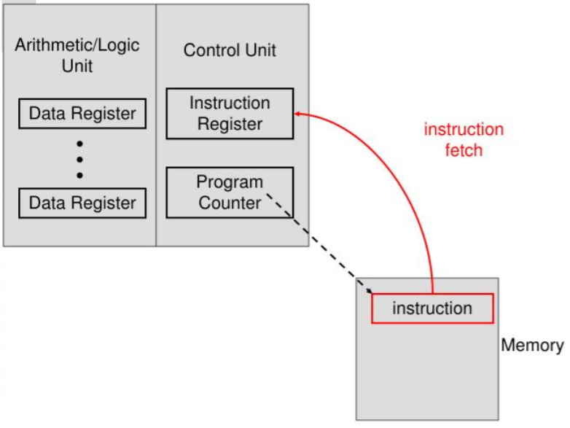

Slide 10
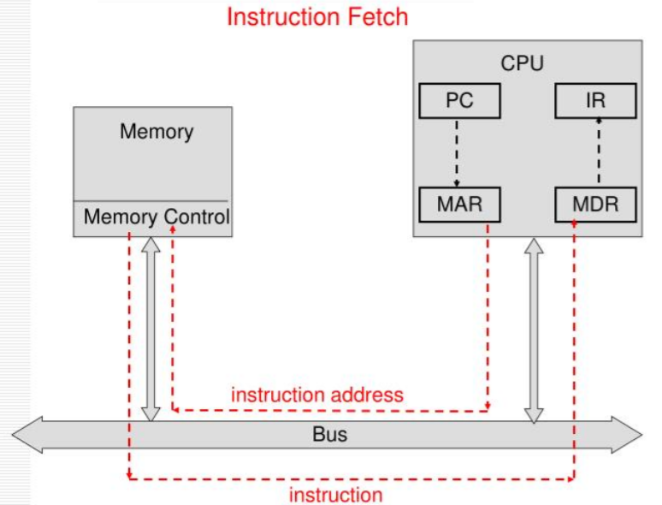

Slide 11
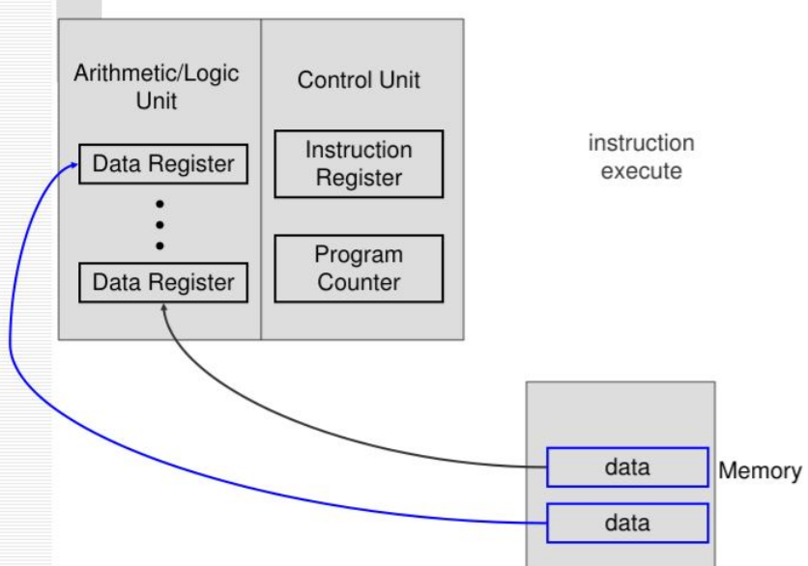

Slide 12
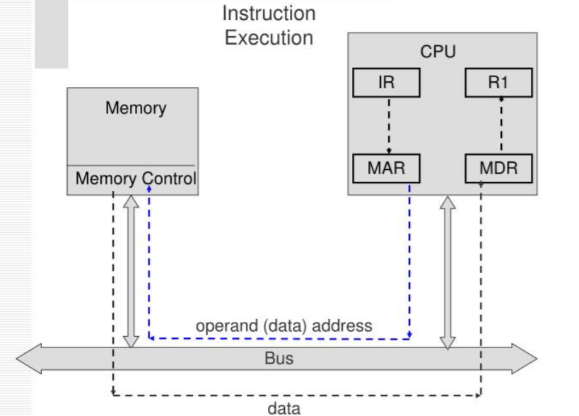

Slide 13
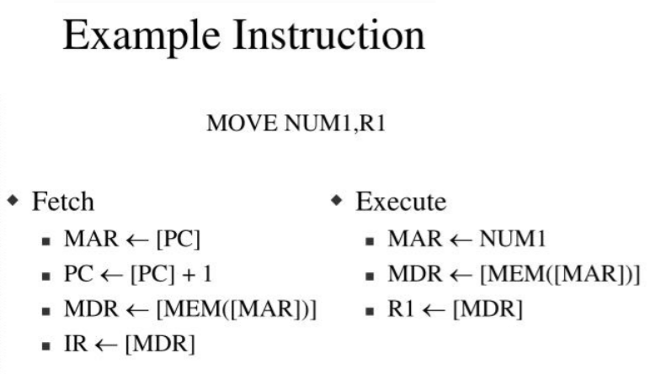

Slide 14
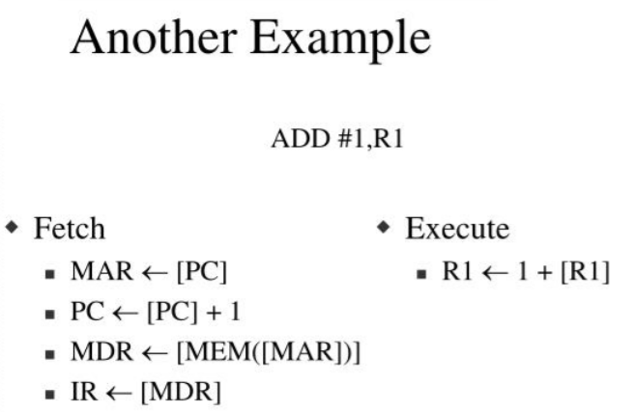

Slide 15
Bus structures
Bits
Parallel transfer
Bus
Single bus
Bus control lines
Buffer registers
Eg. Printer and cpu

Slide 16
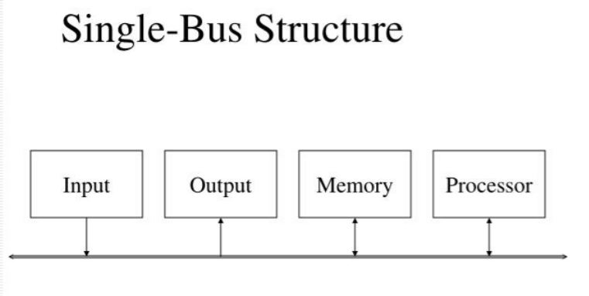

Slide 17
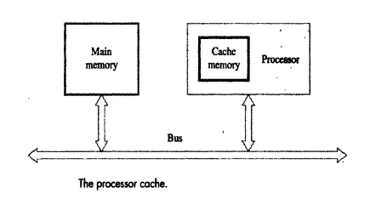
Performance
Hardware
Instruction set
Elapsed time
Processor time
Processor clock
Clock cycle
P
R=1/P

Slide 18

Continued
Performance equation
N→ no. of instructions
No. of Basic steps/Clk cycle → S

Slide 19
Pipelining and superscalar operations
Pipelining
Eg: Add R1,R2,R3
Multiple functional units
Superscalar execution
Multiple steps/ clk cycle
Clock rate
IC
No. of basic steps/ clk cycle
Cache
T→ should be reduced

Slide 20


Continued
Instruction set
RISC
CISC
Pipelining
Compiler
Optimizer
Performance measurement
Exe time - T

Slide 21
Machine Instructions and Programs
Instruction set architecture
Instruction set
Addressing modes

Slide 22


Number, Arithmetic operations and characters
Number representation
N bit vector
Sign and magnitude
1’s complement
2’s complement

Slide 23
Addition of positive numbers
Addition and subtraction of signed numbers
Examples
+5 + +3
+5 - +3 ➔ +5-3
+2 + -4
-7 - -5

Slide 24

Overflow in integer arithmetic

Slide 25
Memory locations and addresses
Storage cells
Word
Word length
Byte
Addresses
Address space
Locations
Byte addressable memory

Slide 26
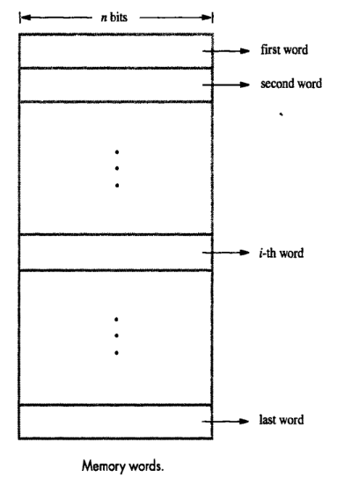
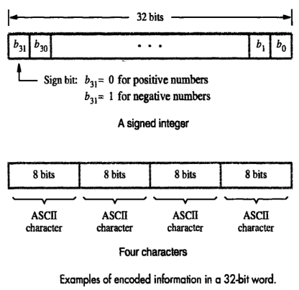
Byte addressability

Slide 27
Big endian and little endian assignments
Big endian
Lower byte address in MSB
Little endian
Lower byte addresses for LSB

Slide 28
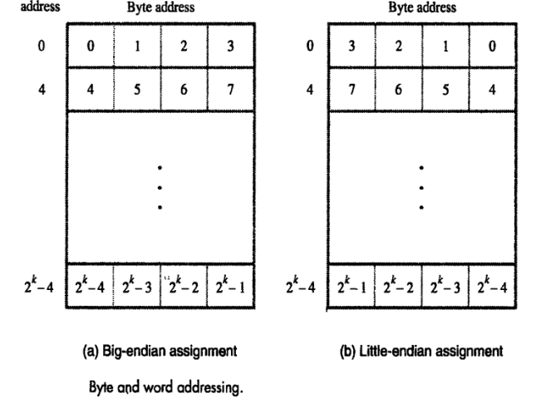

Slide 29
Word alignment
Aligned addresses
0,4,8 → 32 bit word length
0,2,4→ 16 bit word length

Slide 30
Accessing numbers, characters and character strings
String
Successive memory locations
Number

Slide 31
Memory operations
Program
Instructions
Data operands
Operations
Load/read/fetch
Store/write

Slide 32
RTN- Register transfer notations
R1← [Loc]
R3←[R1]+[R2]

Slide 33
Assembly language notation
Move Loc,R1
Add R1,R2,R3

Slide 34
Basic instruction types
High level language instruction
C=a+b
C←[A]+[B]
Three address instruction for addition
Add a,b,c
Operation src1,src2,dest
32 bit instruction→ word length
Two address instruction address
Operation src,dest
Add A,B
B←[A]+[B]

Slide 35
Continued
Move B,C
C←[B]
C=a+b
Move B,C
Add A,c
One address instruction for addition
Add A
Load B
ADD C
Store D

Slide 36
Continued
Load A,Ri
Store Ri,A
Add A,Ri
------------
Add Ri,Rj
Add Ri,Rj,Rk
Move src,dest

Slide 37
Continued
C=a+b
Move A,Ri
Move B,Rj
Add Ri,Rj
Move Rj,C
C=a+b
Move a,ri
Add B,Rj
Move Ri,c

Slide 38
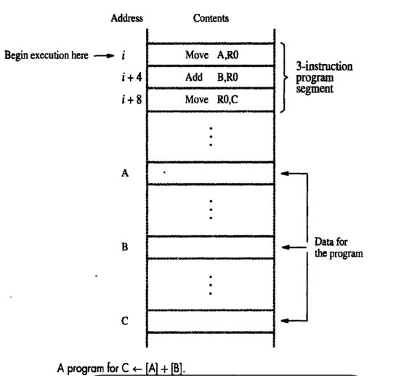
Instruction execution and straight line sequencing

Slide 39
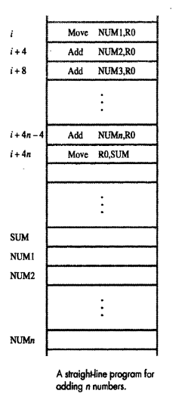
Branching

Slide 40
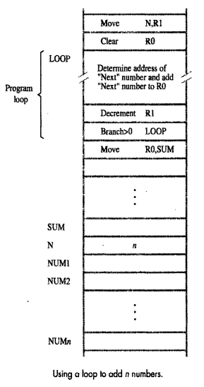

Slide 41
Condition codes (flags)
N
Z
V
C

Slide 42
Generating memory addresses
Memory operand addresses

Slide 43
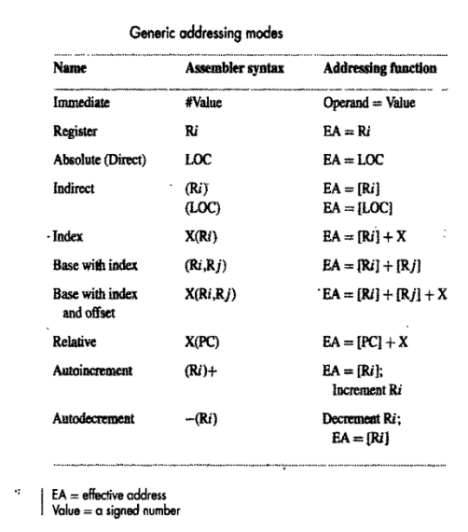
Addressing modes
Different ways to access operands

Slide 44
Implementation of variables and constants
Register mode
Absolute mode
Move loc,R2
Integer A,B;
Immediate mode
Move #200,R0
A=B+6
Move B,R1
Add #6,R1
Move R1,A

Slide 45
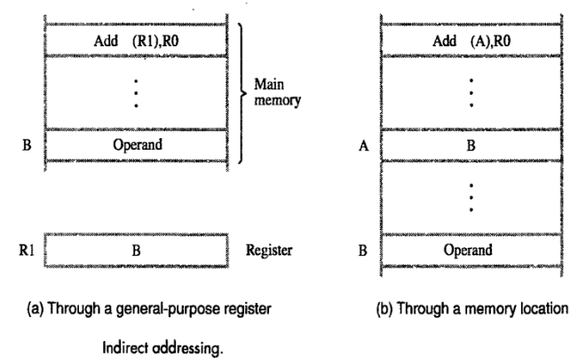
Instruction and pointers
EA
Indirect mode
pointer

Slide 46
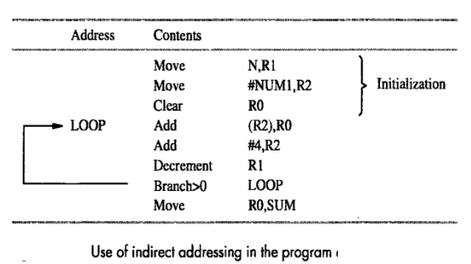

Slide 47
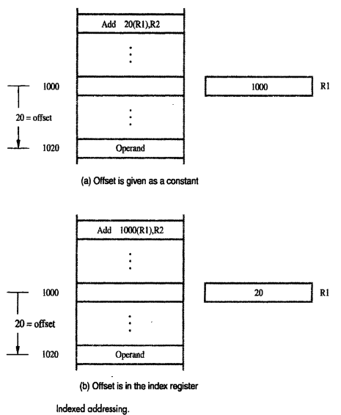
Indexing and arrays
Index mode
X(Ri)
EA=X+[Ri]
Offset or displacement
X(Ri,Rj)
(Ri,Rj)

Slide 48
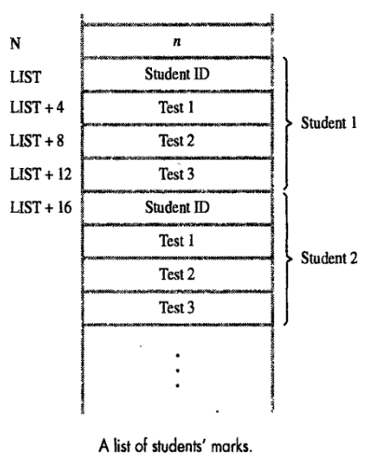

Slide 49
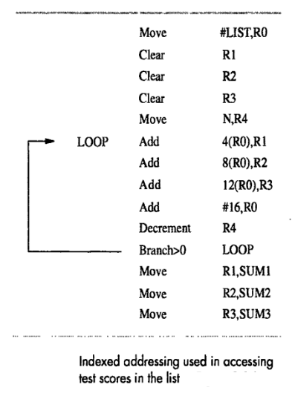

Slide 50
Relative addressing
X(PC)
Branch > 0 loop

Slide 51
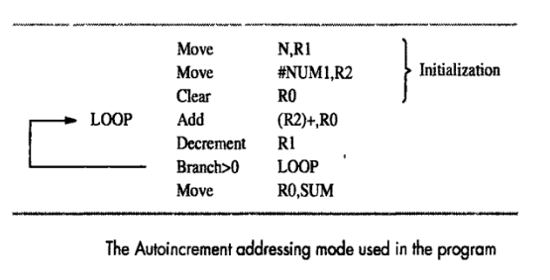
Additional modes
Auto increment mode
(Ri)+
Auto decrement mode
-(Ri)

